Slide 1

Revolutionizing Chocolates and Sweets
Join us on a journey to explore the key aspects of Milly's Chocolate Factory's new database management system, from design to implementation.

Slide 2

Estian Stander
Tarina Snyman
Zac Myburgh
Petri Loots

Slide 3

The Existing System
1
Limitations
2
Challenges
The current system is paper-based and inefficient, slowing down customer service and limiting growth potential.
Due to the manual nature of the system, data input errors are common, leading to incorrect orders and stock levels.
3
Opportunities
The implementation of an automated system will enable better stock management, order tracking and customer communication.

Slide 4

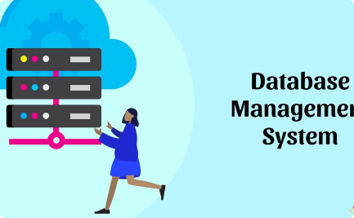

Milly's Vision and Goals
Vision
Goals
Strategies
Milly wants to create a dynamic yet personalized approach to managing customer relationships and communication.
Create a user-friendly and efficient database management system across all branches.
Improve customer service through better tracking of orders and stock levels, enhance employee productivity and streamline internal processes.

Slide 5
The New Database Management System
1
2
3
Features
Functionality
Database Design
The new system will store information on customers, employees, orders, and inventory in a centralized database.
It will be accessible from all branches, enabling employees to enter orders, update stock levels and fulfill orders efficiently.
The database will have a relational schema, consisting of tables for orders, customers, items, and employees.

Slide 6
Implementation of the New System
Implementation Plan
Testing and Training
Support and Maintenance
A phased approach, starting with a pilot launch across two branches, will be followed by a full rollout over six months.
During the pilot phase, testing and feedback will be used to fine-tune the system and training will be provided to all employees.
24/7 technical support and regular maintenance checkups will be provided to ensure the system runs smoothly.

Slide 7
Employees and Skills Management
Employees
Skills
56 employees
Personal & professional skills
Name, Address, Tel no.
Name, Age, Relationship
Date of hire, Title, Salary
Works in one

Slide 8
Customers and Accounts
Customers
Accounts
Customer details
Balance
Order history
Last Payment Date
May have one or more accounts
Last Payment Amount
May order from any branch
Type

Slide 9



Branches and Inventory
Inventory
Branches
Warehouse
Branches will be able to manage and track stock levels more efficiently, reducing wastage and errors.
Details on each branch, such as location, storage space and types of items sold, will be recorded.
The warehouse will be able to receive and send out orders, and track inventory across all branches and orders.

Slide 10
Benefits of the New System
Simplified Communication
The system will enhance communication and collaboration across different branches and employees.
1
2
3
Improved Efficiency
Enhanced Customer Experience
The automated database management system will make inventory management, order tracking, and customer communication more efficient and timely.
Customers will receive better service, through improved order tracking, custom communication and support.

Slide 11
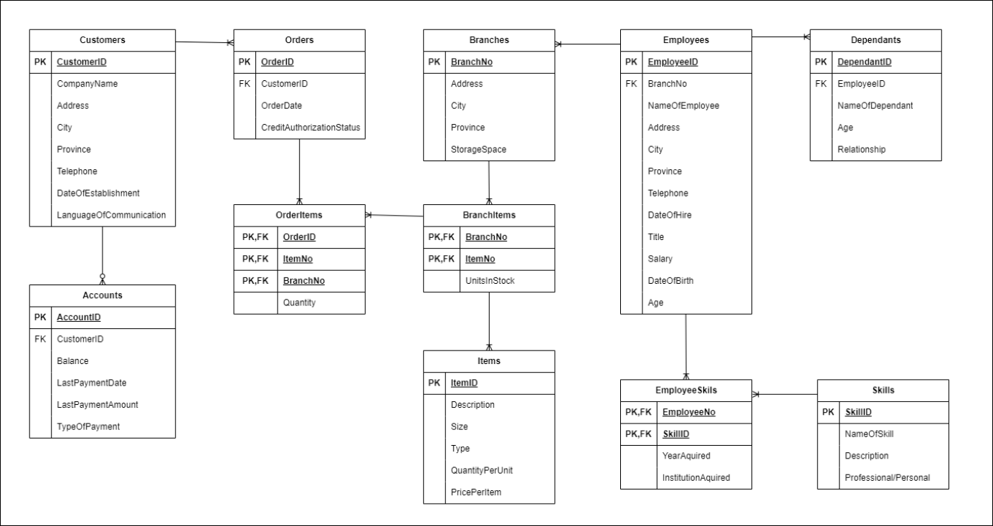
The ERD

Slide 12

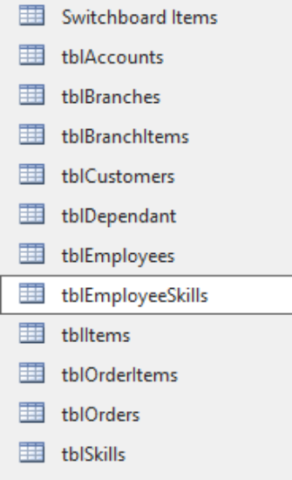
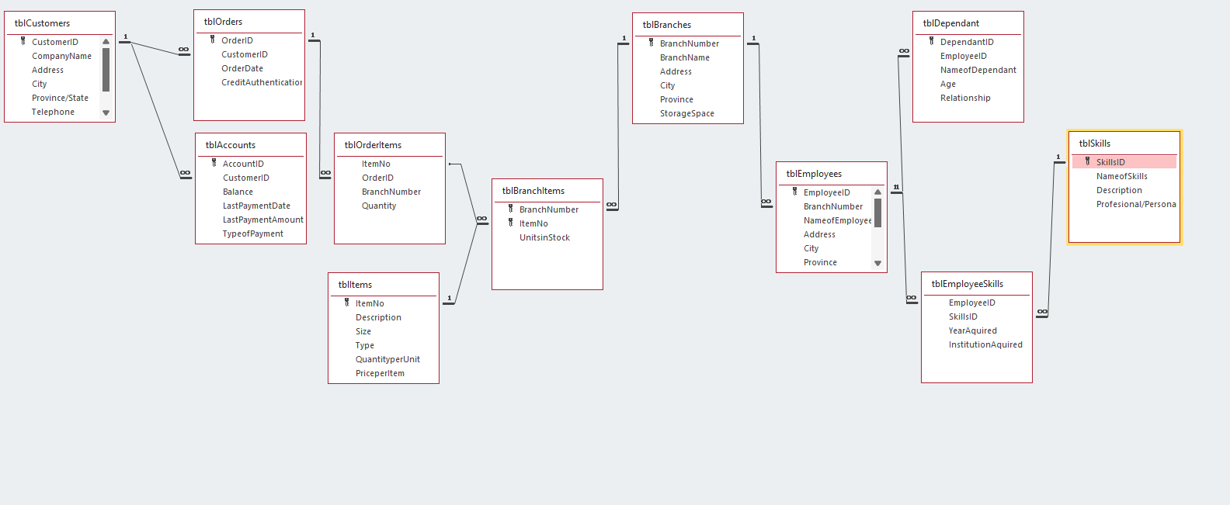
The Tables
The tables holding all essential data
The Relationships

Slide 13

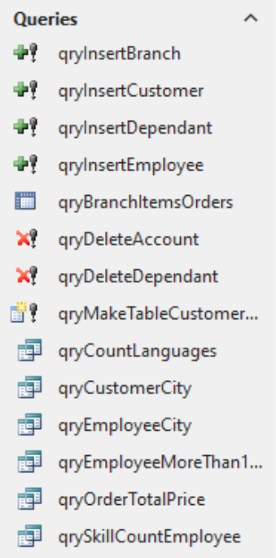
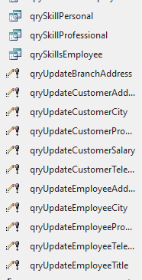
The Queries

Slide 14

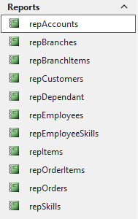
The Reports
In summary, reports are essential in a database system because they help in analyzing data, making informed decisions, complying with regulations, communicating information effectively, tracking progress, identifying issues, and more. They provide a structured and organized way to present data, enabling stakeholders to extract meaningful insights and drive the success of an organization or project.

Slide 15

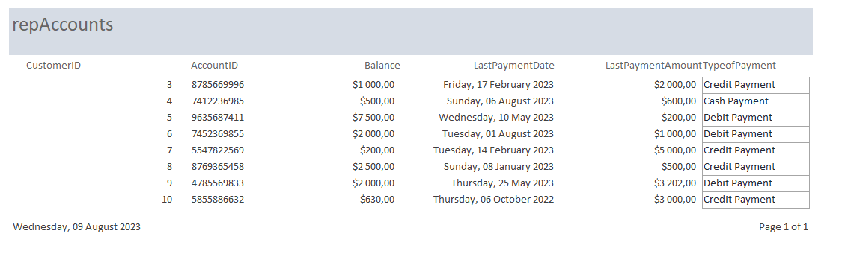
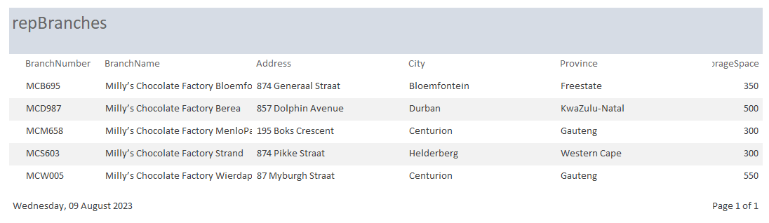

Slide 16
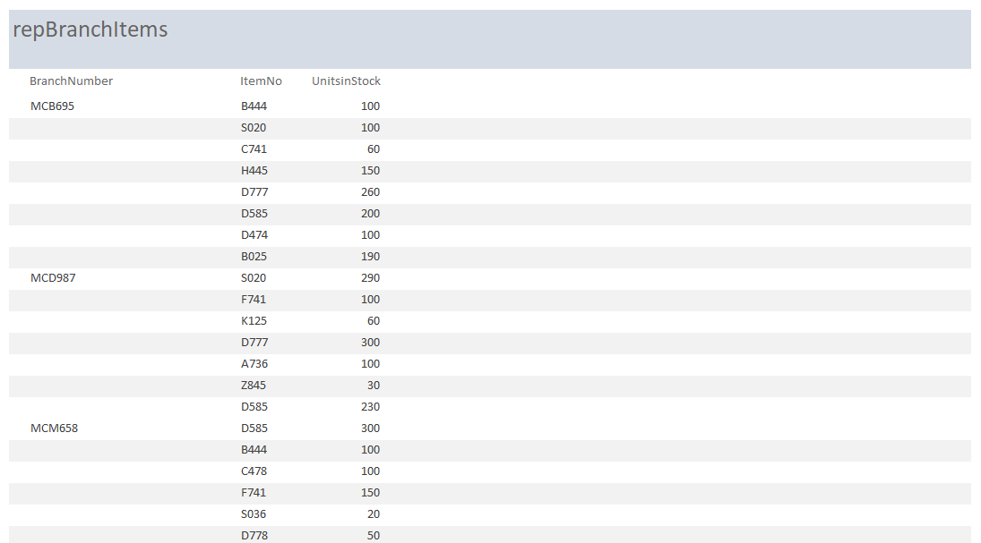

Slide 17
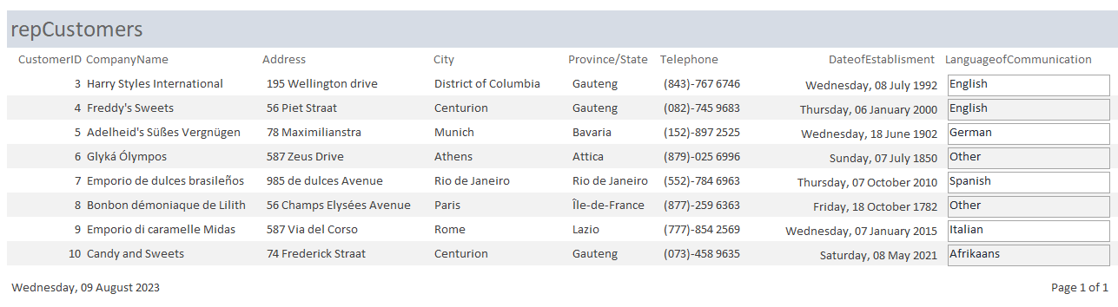
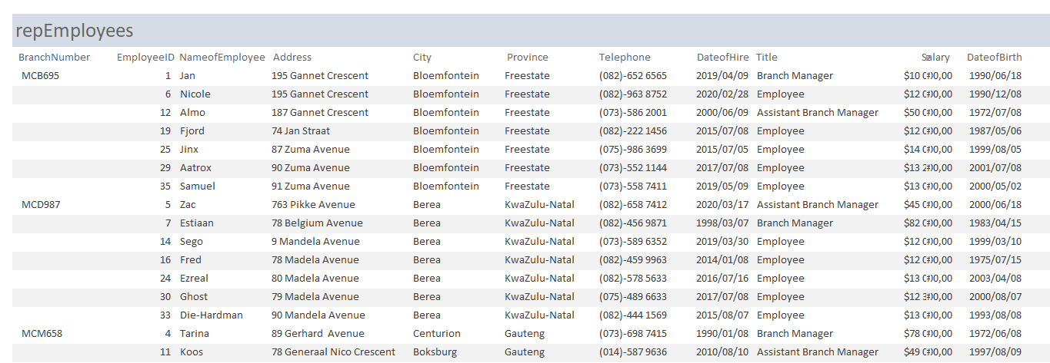

Slide 18
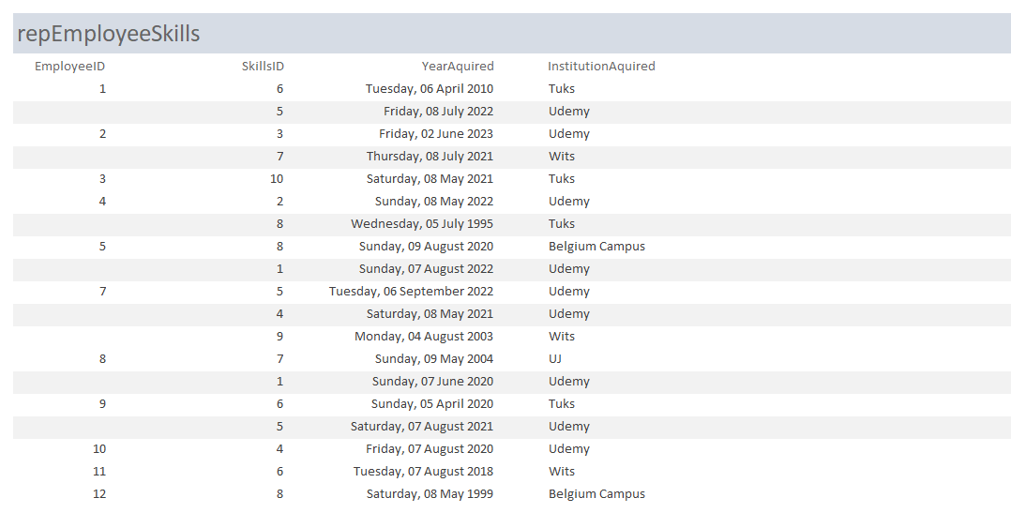
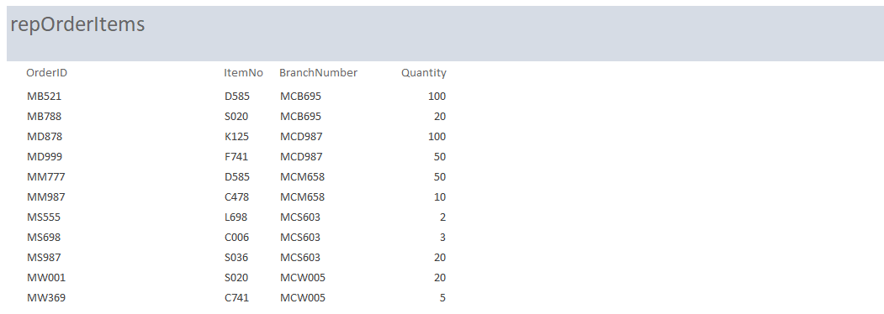

Slide 19
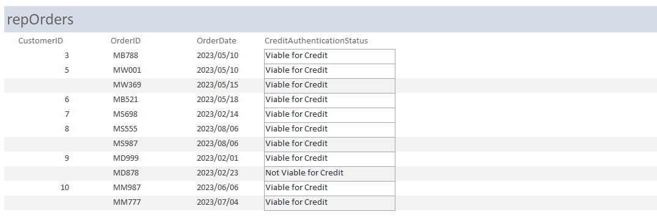
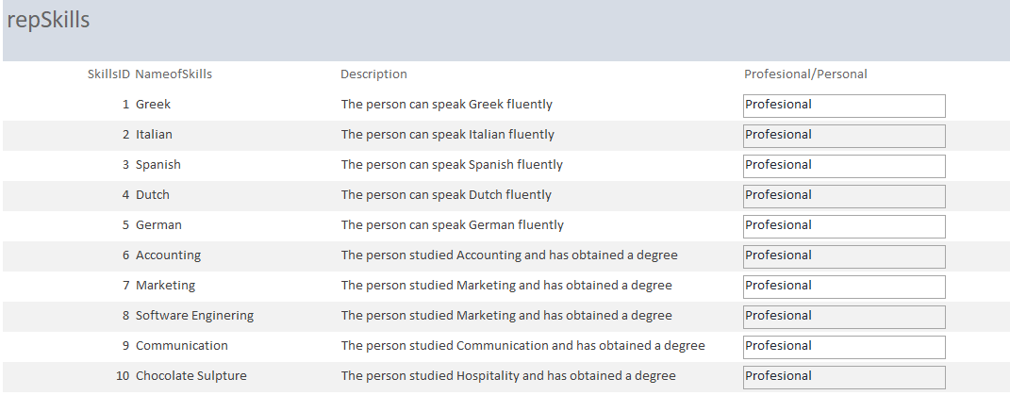

Slide 20

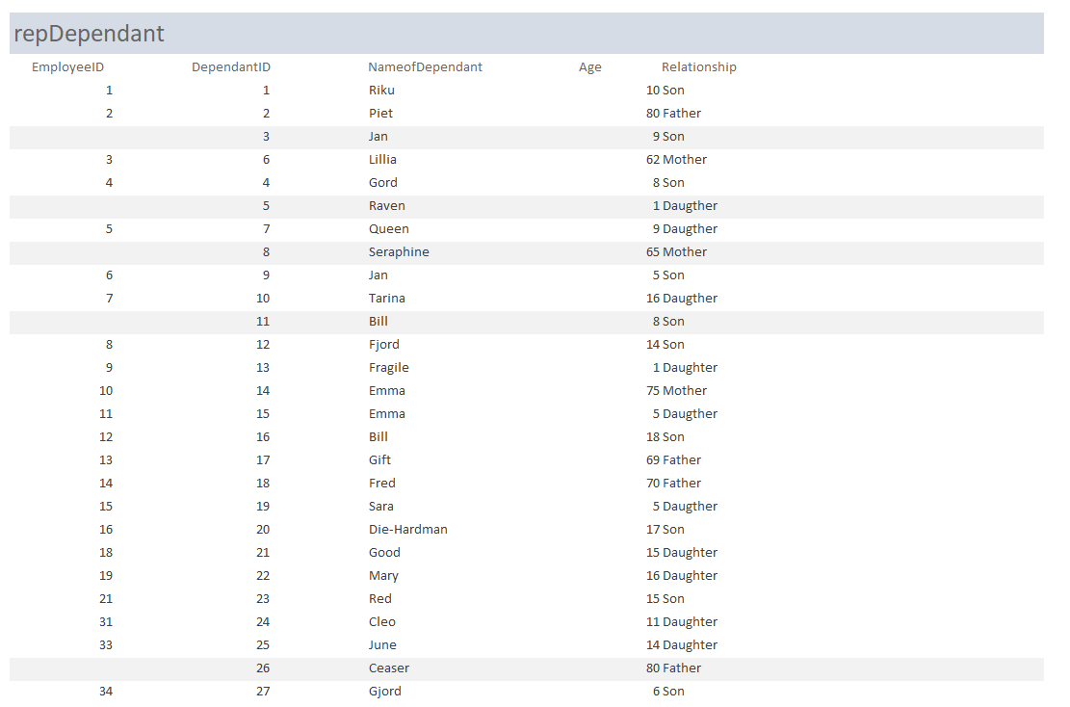

Slide 21
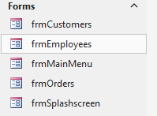
The Forms
In summary, forms are important in a database system because they provide a user-friendly and structured way to enter data, maintain data quality, ensure data security, streamline workflows, and improve the overall user experience. They bridge the gap between users and the underlying database, making it easier for individuals to interact with and contribute to the database while adhering to data standards and best practices.

Slide 22
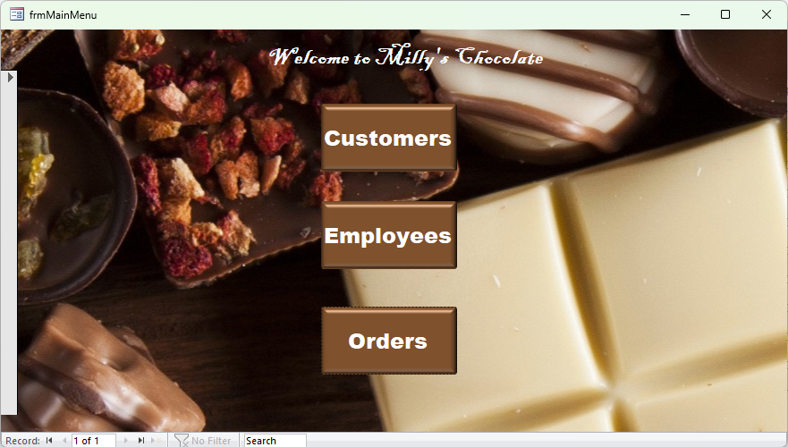

a
The Main Menu
The Splashscreen

Slide 23
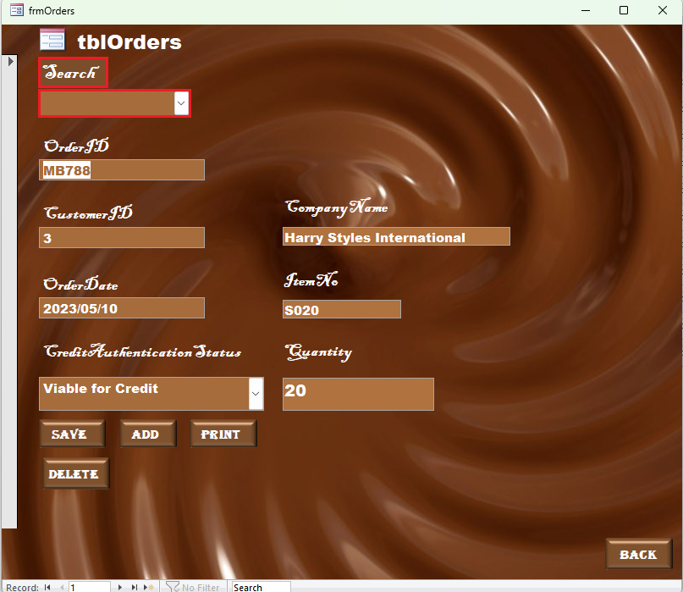
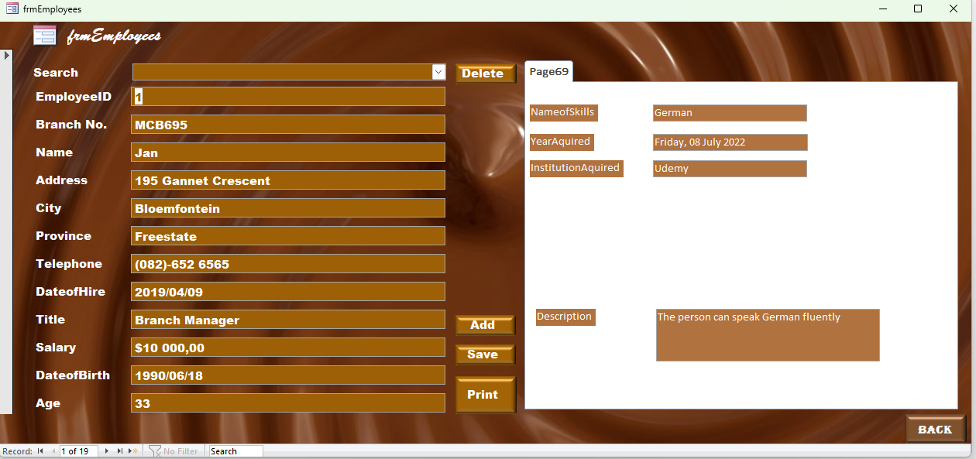

Slide 24
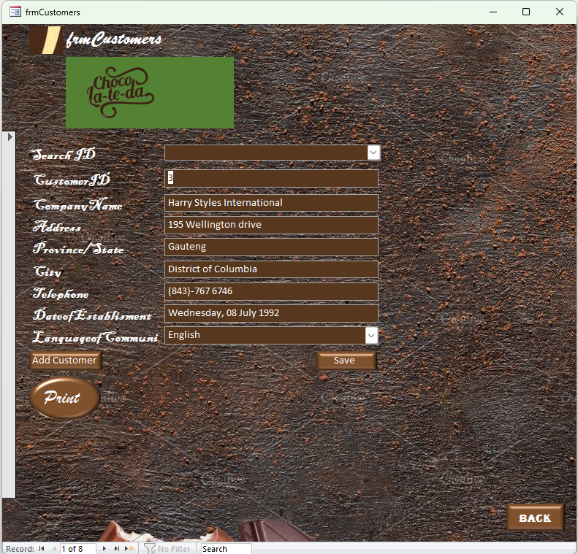

Slide 25
The Forms

